Slide 1

LOAN APPLICATIONS REPORT USING TABLEAU

Slide 2
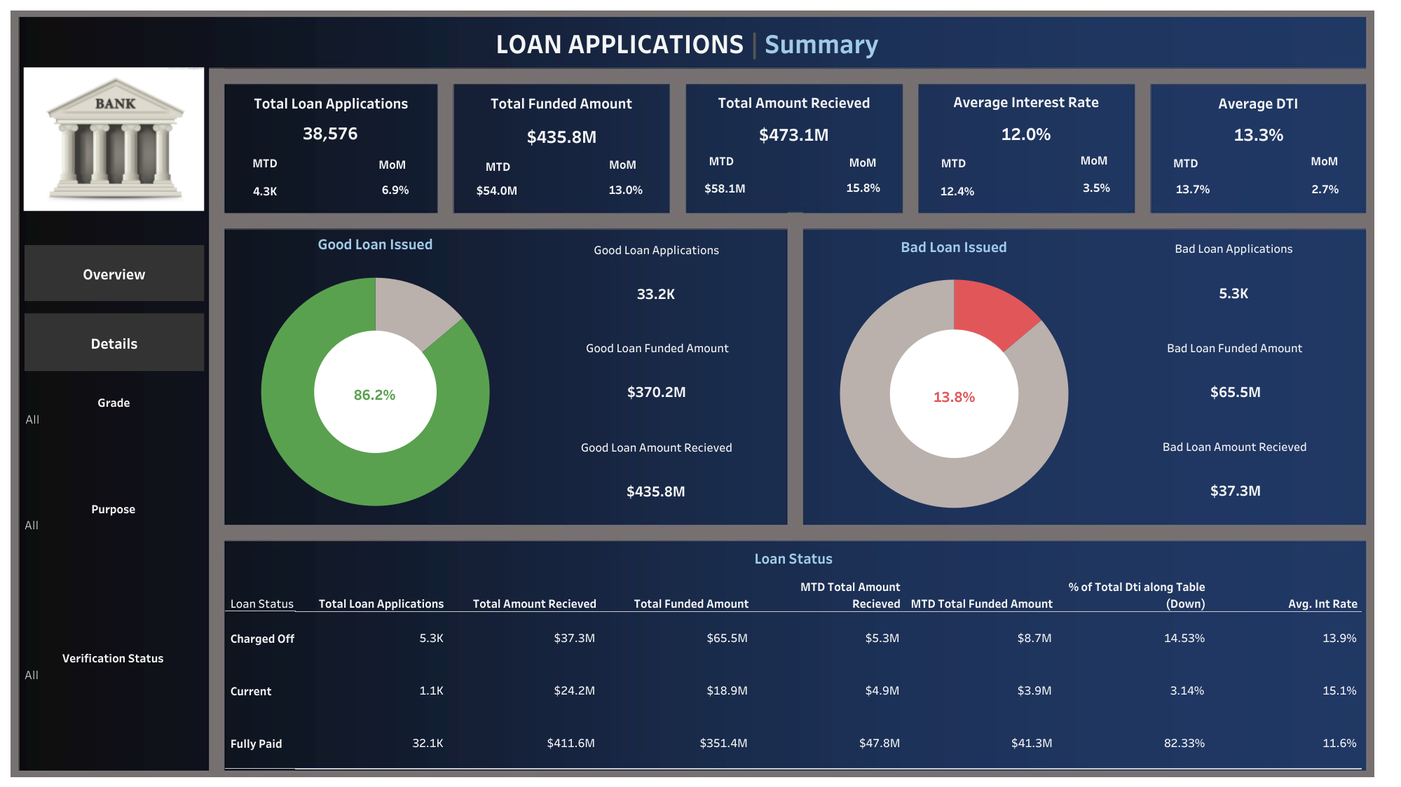

Slide 3
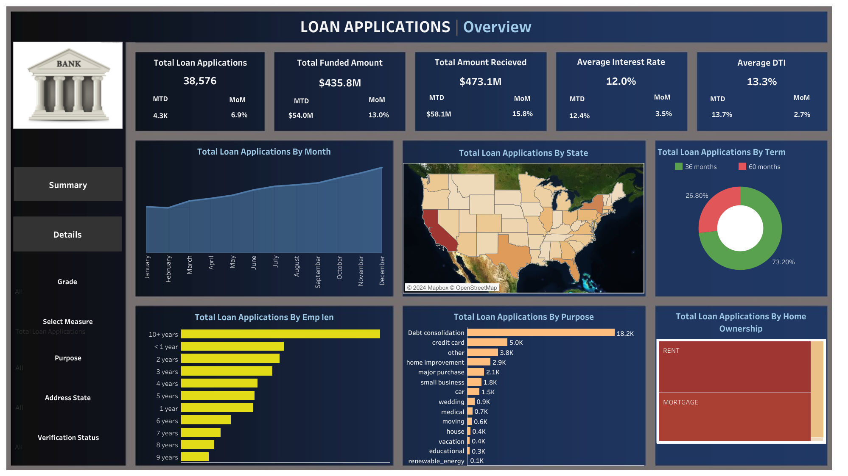

Slide 4
